Slide 1
Sarhad College Student Admission System
Project By :
Rohan Viraj Deshpande

Slide 2
Base Idea of the Project :
To Automate the System, increase Security & reduce the Human Efforts done by Office Staff during the Admission Process
To aid the Placement Officer with a Report of Students’ satisfying specified criteria

Slide 3
Old System
Current Status : During the Admission System, data is collected manually from Printed Challans and Stored in a Excel File (Manually)
Technology Used :
BackEnd - MS Excel
FrontEnd - MS Excel/Printed Challans

Slide 4
New System
Proposed System: Automated System with increased Security to reduce Human Efforts and Errors during Admission Process
Technology Used :
BackEnd - MYSQL DB
FrontEnd - Java Swing

Slide 5
DB Structure
StudentAdmission_DataDictionary_Modified.xlsx

Slide 6
Diagrams

Slide 7
Entity Relationship Diagram
StudentAdmission_ERD.docx
Data Flow Diagram
StudentAdmission_DFD.docx

Slide 8
UML Diagrams
Use Case Diagram
StudentAdmission_UsecaseDiagram.docx
Activity Diagram
StudentAdmission_ActivityDiagram.docx
Sequence Diagram
StudentAdmission_SequenceDiagram.docx
Class Diagram
StudentAdmission_ClassDiagram.docx

Slide 9
I/P & O/P
Screenshots

Slide 10
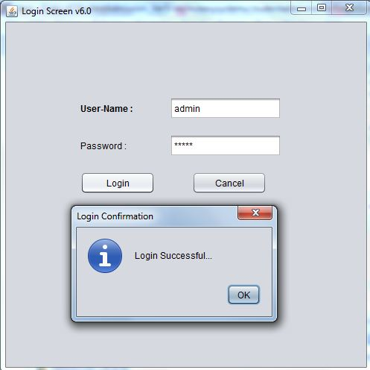
Login Screen

Slide 11
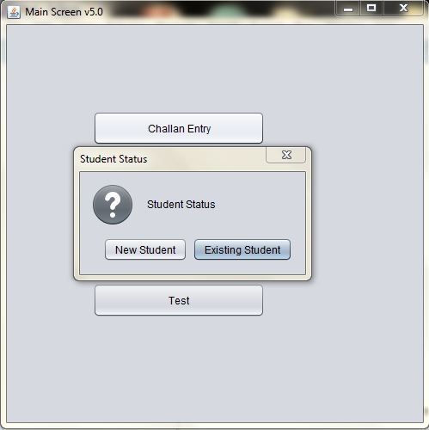
Main Screen : Select Student Status

Slide 12
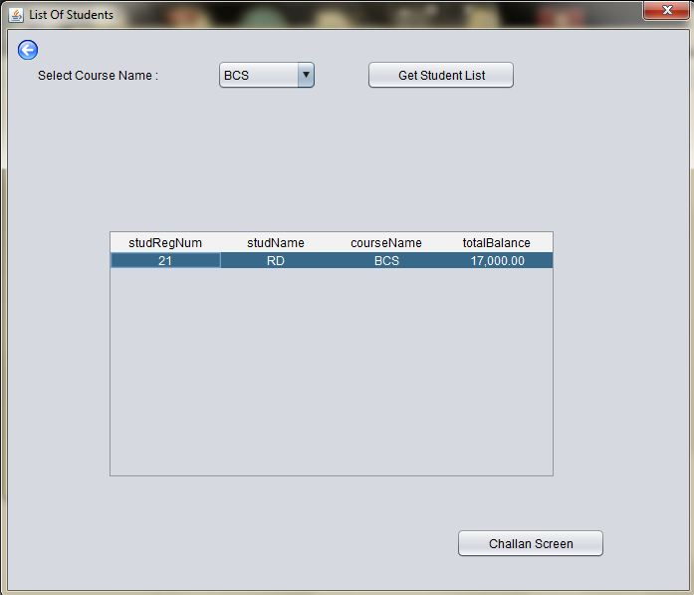
Select Existing Student depending on course

Slide 13
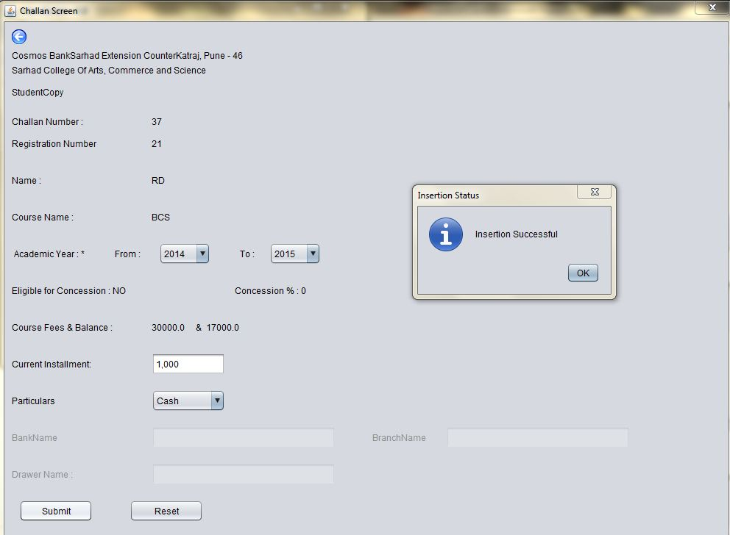
Challan Screen Entry

Slide 14
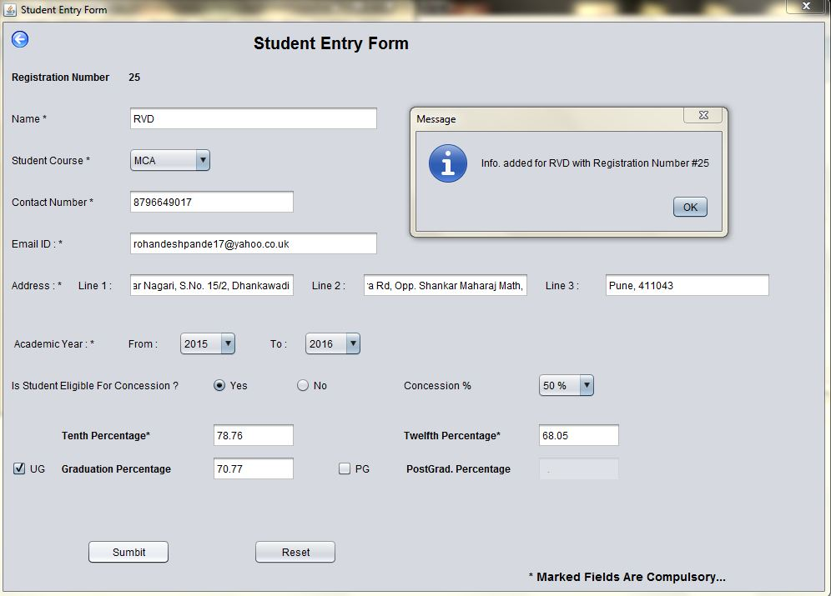
Student Entry Form

Slide 15
Reports

Slide 16
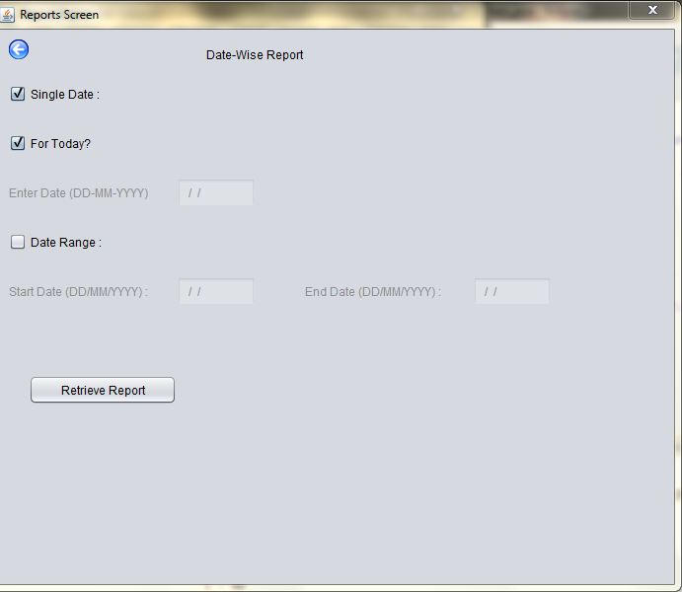
Student Fees Collection Report : Single Date

Slide 17
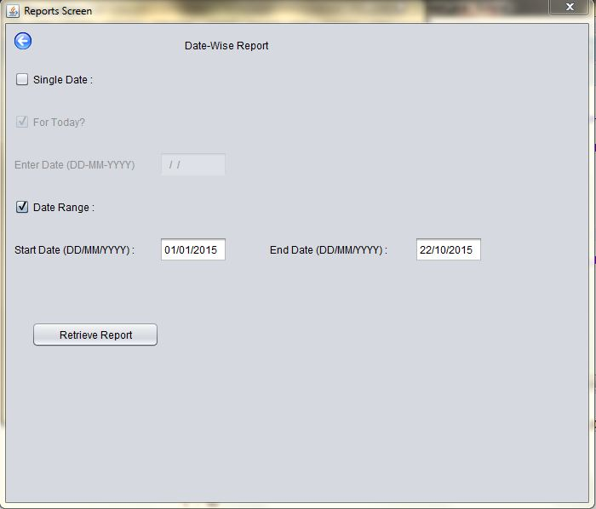
Student Fees Collection Report : Date Range

Slide 18
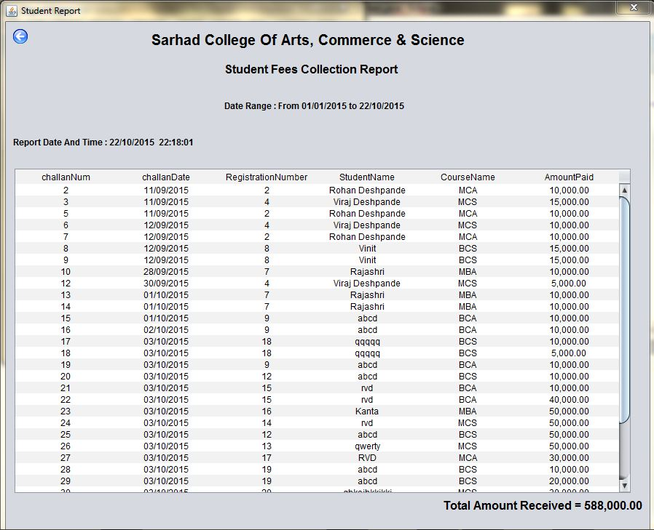
Date Report Format

Slide 19
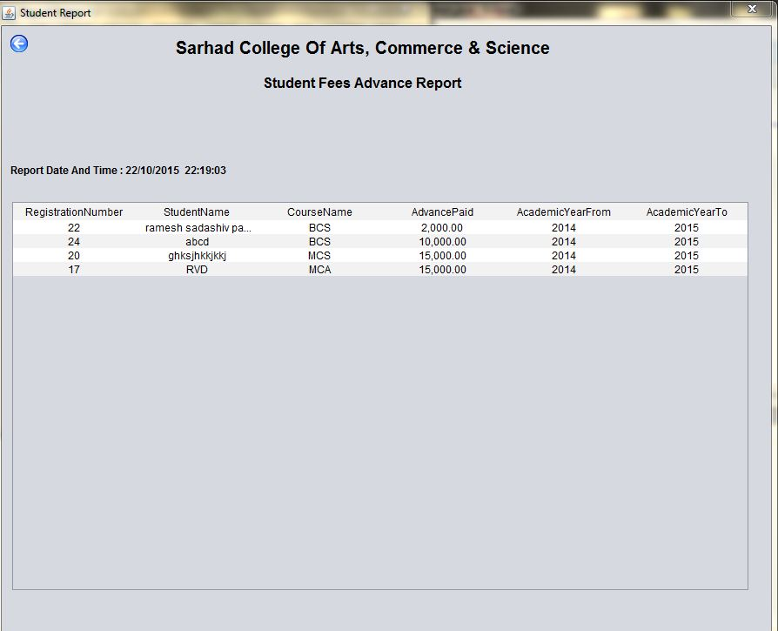
Advance Fees Paid Student List

Slide 20
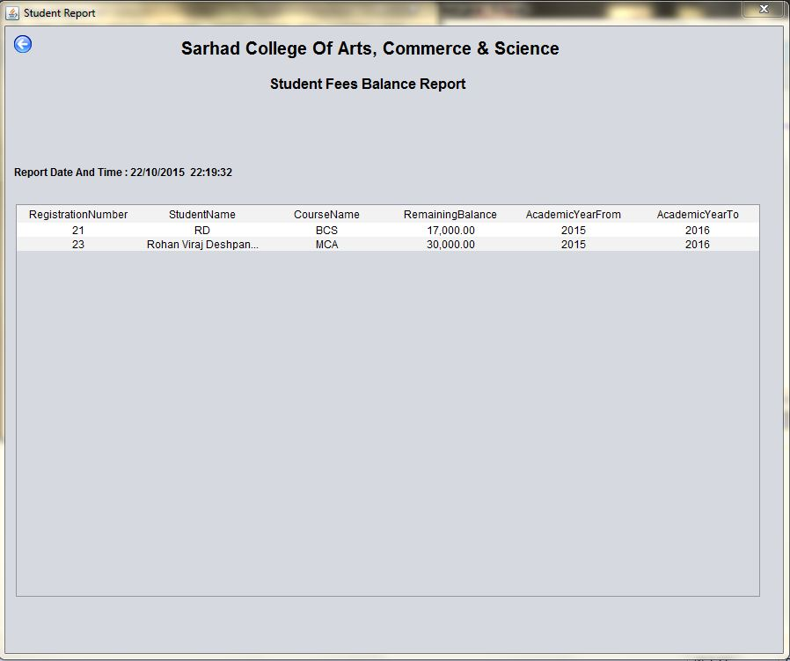
List of Students having Outstanding Fees

Slide 21
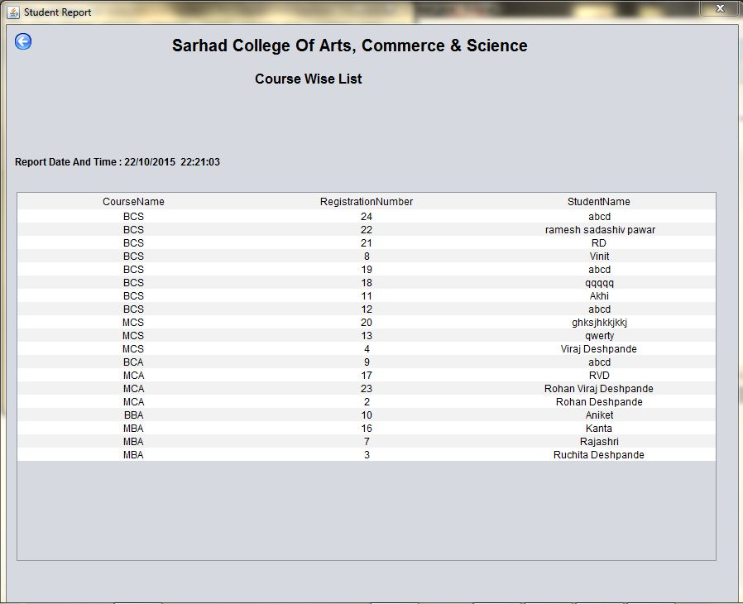
Course-wise Student List

Slide 22
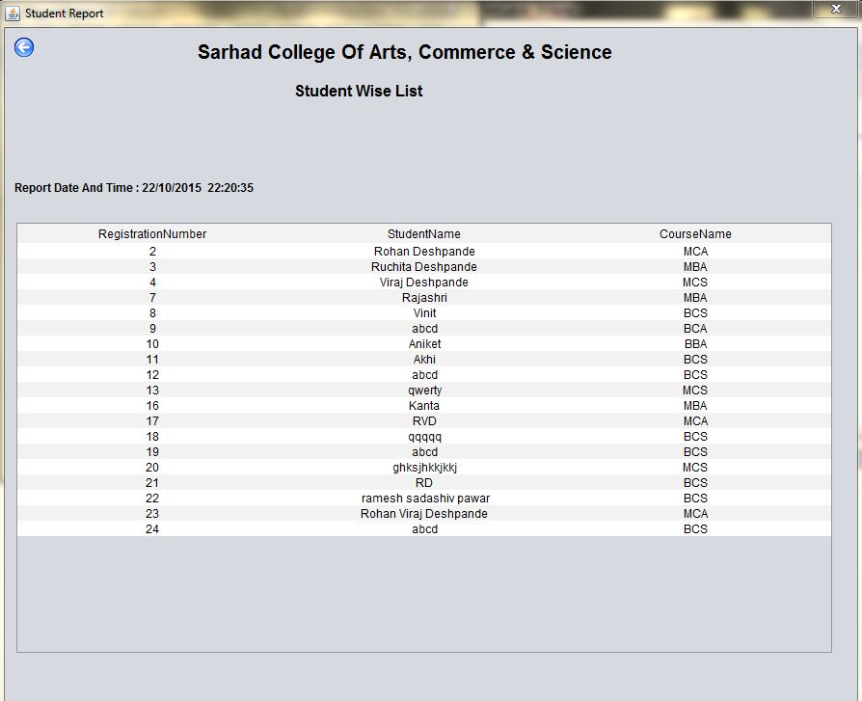
Registration No. wise Student List

Slide 23
Exception Screenshots

Slide 24
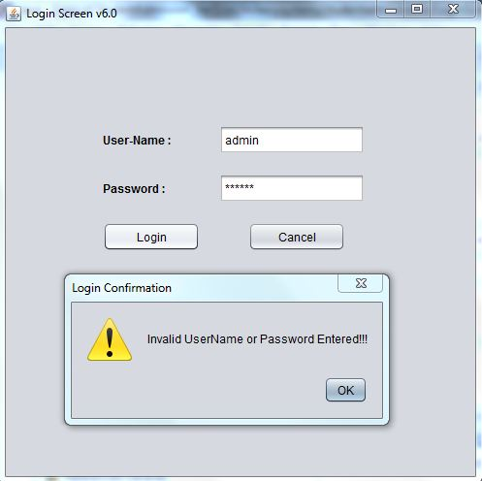
Incorrect Login

Slide 25
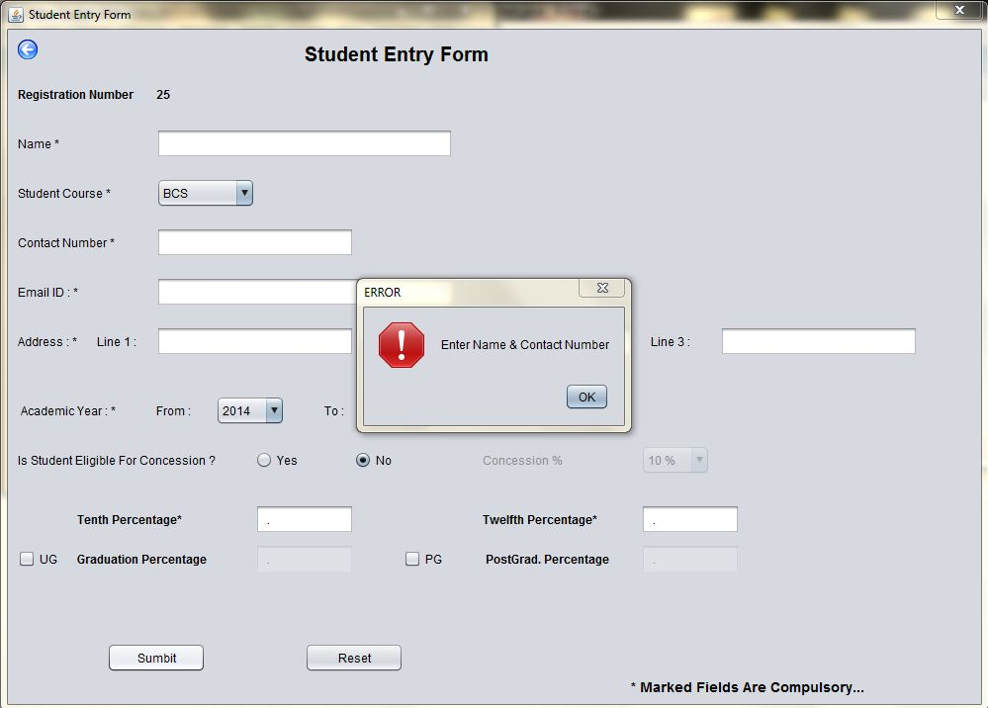
Student Entry : No Input

Slide 26
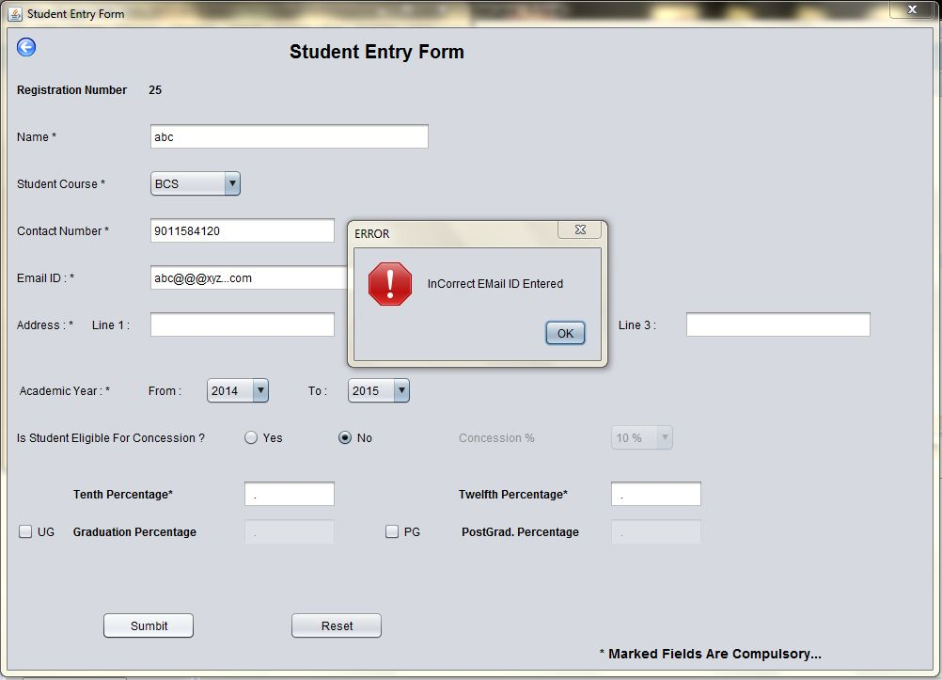
Student Entry : Invalid Email-ID

Slide 27
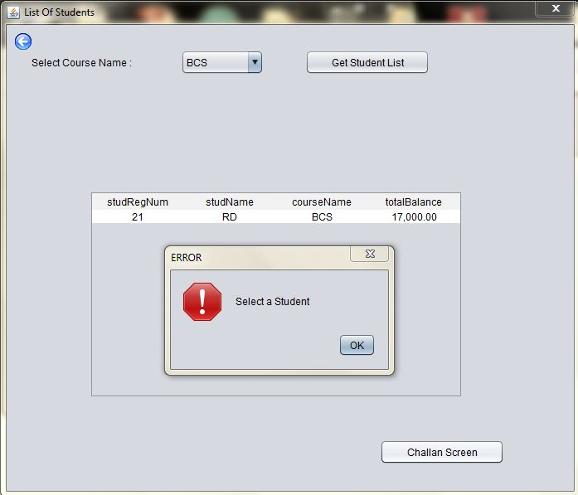
Student List : If Student Not Selected

Slide 28
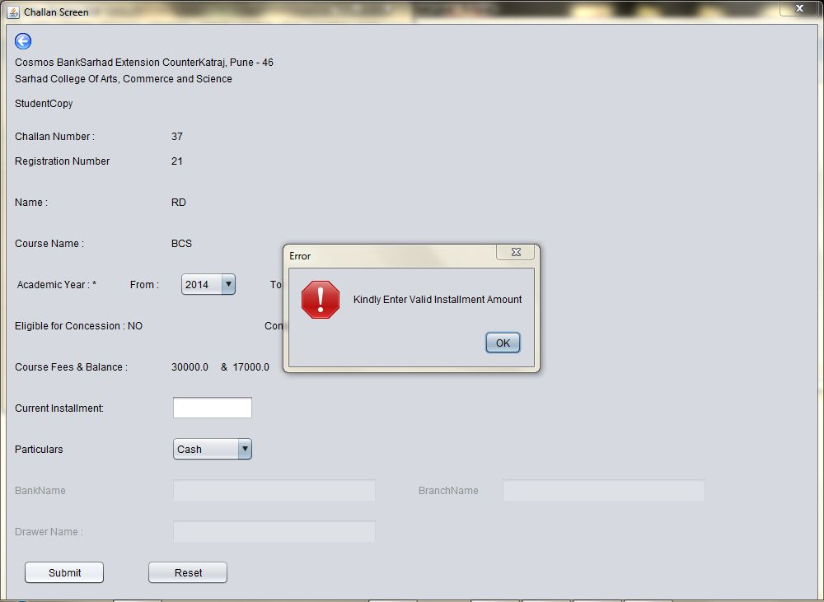
Challan Entry : If Installment Not Entered

Slide 29
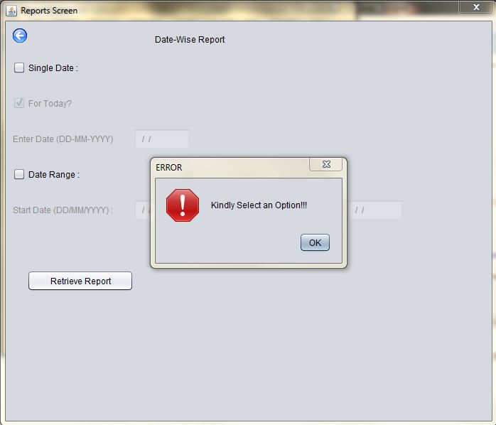
Date Report : If No Option is Selected

Slide 30
Limitations
As it is a Console-Based Application So a Few Limitations Persist :
No facilities provided for NEFT/RTGS Payment
Online Payment through PayPal or similar third-party services is not possible

Slide 31
Future Enhancements
To add the Exam Fees Receipt Facility into the Application
To add the School & Junior College Student’s Admission Process into the Application
To provide the TPO ( i.e. the Training & Placement Officer ) with Percentage-wise Student List

Slide 32
Conclusion
To conclude, let me give you an overview of the Functionalities provided by my Project:
To facilitate Automation & easy monitoring of the every aspect of the Students’ Admission Process
To track down, important aspects like Balance Fees & Advance Fees, paid by the Student. (In other words, Book-keeping becomes Easy and Accurate )
To aid the Placement Process by Providing Student Profile

Slide 33
References Used
http://www.javatpoint.com/
http://java4s.com/
https://docs.oracle.com/javase/tutorial/
http://tutorialspoint.com/
http://stackoverflow.com/
YouTube Tutorials

